Slide 1

Configuring PSRemoting security and logging
Mike Kanakos

Slide 2

Who Am I ?
MetLife: AD Engineer & PowerShell Fanatic
PowerShell.org: Director of Community Engagement
Blog: www.networkadm.in
Writer: 4sysops.com & ipswitch.com
Contributor: PowerShell Conference Book vol. 1 & vol. 2
Twitter: @MikeKanakos
Email: mkanakos@gmail.com
GitHub: github.com/compwiz32

Slide 3

Today’s Agenda
What is PSRemoting?
How sessions are created
How to enable remoting
PowerShell authentication
How to control access to remote nodes
Logging PS activity
Tips for talking to your InfoSec team/CISO

Slide 4
Have you heard this in your org?
“I would like to enable PS Remoting for our computers…”
Are you crazy? PowerShell is used in all the malware attacks now… Why would we run this on our network?
What if we get owned? I don’t want an attacker having unlimited access in my network?
We will not allow running WinRM/Remoting on our network.

Slide 5
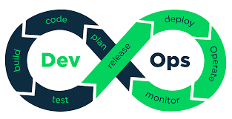

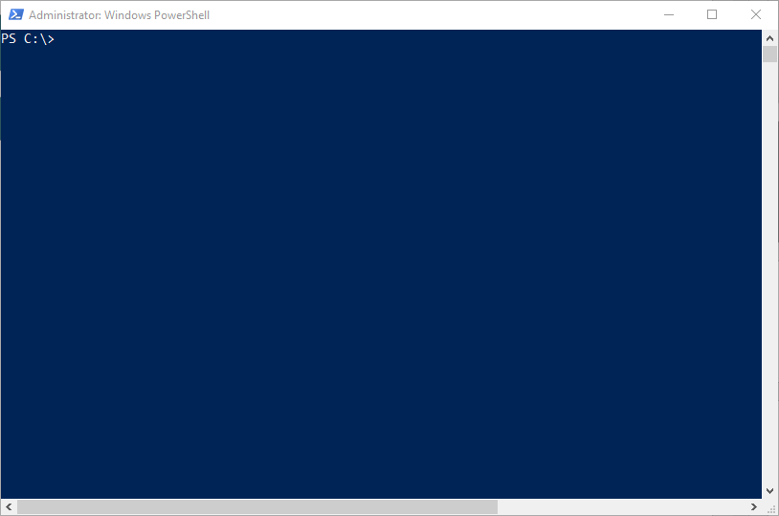


The IT world has changed…

Slide 6
What is PowerShell Remoting?
Connecting to a remote computer via Windows Remoting
CIM cmdlets & Invoke-Command = PSRemoting
PS Remoting runs via the Windows Remote Management service (WinRM)
WinRM uses the WSMan protocol to make the connection to another machine (http: 5985 & https:5986)
All connections are encrypted by default

Slide 7
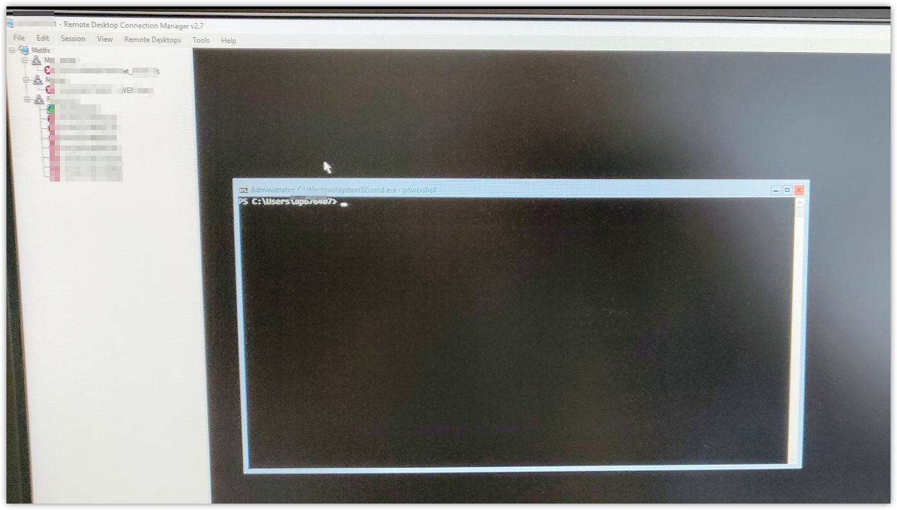
Not everyone has REMOTING figured out yet…

Slide 8
CMI vs WMI: What’s the Difference?
CIM:
WMI:
Firewall friendly.
Only needs 2 ports open:
HTTP: 5985, HTTPS: 5986
Authentication via Kerberos
WS-MAN
Not firewall friendly
TCP 135,445 must be open
Also, dynamic assigned ports between 1024 and 1034
DCOM & RPC

Slide 9



How does Remoting work?
http 5985 / https 5986
Encrypted connection (256 bit key)
Local PowerShell session authenticates against remote client. - Enter-PSSession
- Invoke-Command
- Any CIM cmdlets
01
Commands typed on the local system are sent to a remote computer and executed locally ON THE REMOTE SYSTEM.
03
The remote system EXECUTES the commands locally and sends the results back to the local system.
04
Identity confirmed. Privileges granted based on local group membership on remote PC
PS session created on remote system via WS-MAN / WinRM
02

Slide 10
PS cmdlets that support remoting
PS C:\> get-command -Noun *cim*
CommandType Name
---------- -------
Cmdlet Get-CimAssociatedInstance
Cmdlet Get-CimClass
Cmdlet Get-CimInstance
Cmdlet Get-CimSession
Cmdlet Invoke-CimMethod
Cmdlet New-CimInstance
Cmdlet New-CimSession
Cmdlet New-CimSessionOption
Cmdlet Register-CimIndicationEvent
Cmdlet Remove-CimInstance
Cmdlet Remove-CimSession
Cmdlet Set-CimInstance
Cmdlet Invoke-Command
PS C:\> get-command -Noun *pssess*
CommandType Name
----------- ------
Cmdlet Connect-PSSession
Cmdlet Disable-PSSessionConfiguration
Cmdlet Disconnect-PSSession
Cmdlet Enable-PSSessionConfiguration
Cmdlet Enter-PSSession
Cmdlet Exit-PSSession
Cmdlet Export-PSSession
Cmdlet Get-PSSession
Cmdlet Get-PSSessionCapability
Cmdlet Get-PSSessionConfiguration
Cmdlet Import-PSSession
Cmdlet New-PSSession
Cmdlet New-PSSessionConfigurationFile
Cmdlet New-PSSessionOption
Cmdlet Receive-PSSession
Cmdlet Register-PSSessionConfiguration
Cmdlet Remove-PSSession
Cmdlet Set-PSSessionConfiguration
Cmdlet Test-PSSessionConfigurationFile
Cmdlet Unregister-PSSessionConfiguration

Slide 11
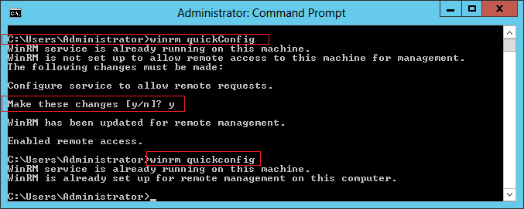
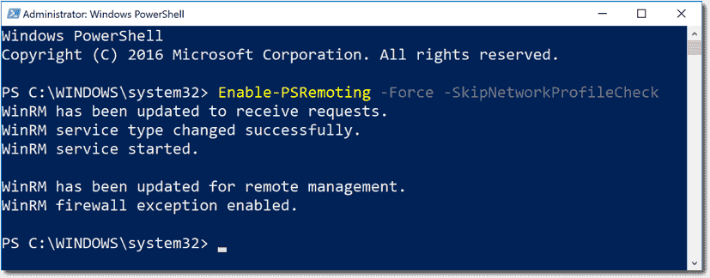
How to Enable PSRemoting

Slide 12
PSRemoting Demo Time!

Slide 13



PSREMOTING: “The Road to a Remote Computer”
PS Remoting is connection & HANDSHAKE between nodes

Slide 14
PowerShell Authentication
PS Remoting was designed to work with Active Directory
Authentication occurs using Kerberos for AD Domain-joined computers
Authentication occurs using NTLM or SSL for workgroup computers
01
02
01
02
Local PowerShell session authenticates against remote client. - Enter-PSSession
- Invoke-Command
- Any CIM cmdlets
Identity confirmed. Privileges granted based on local group membership on remote PC
PS session created on remote system via WS-MAN / WinRM

Slide 15
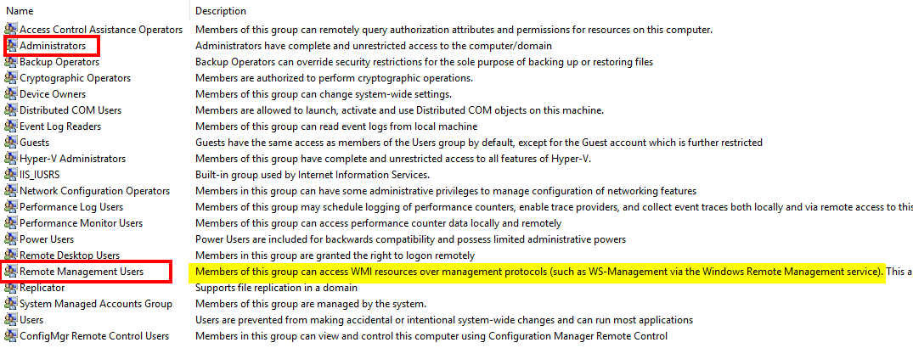
Local Group Membership
Remote Management Users = Read Access to client

Slide 16
Enabling PSREMOTING via Group Policy
Enabling WINRM Service
Setting WINRM to Auto Start
Allow WinRM through the client firewall
Notes:
Via GPO ia how most people will do this…
3 steps – super simple

Slide 17
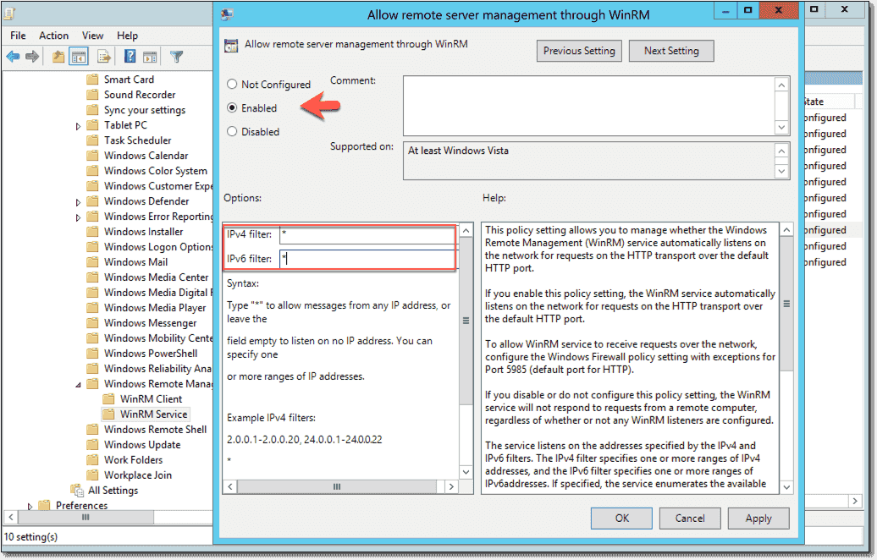
Enabling PSREMOTING with Group Policy
Computer Configuration > Policies > Administrative Templates > Windows Components > Windows Remote Management (WinRM) > WinRM Service
Notes:
Enable remote management (enable /disable)
IP filtering… let’s come back to this…

Slide 18
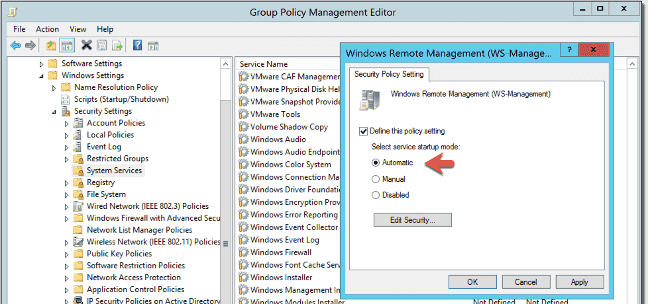
Enabling PSREMOTING with Group Policy
Computer Configuration > Policies > Windows Settings > Security Settings > System Services > Windows Remote Management (WS-Management)
Notes:
Service startup - enable / disable

Slide 19
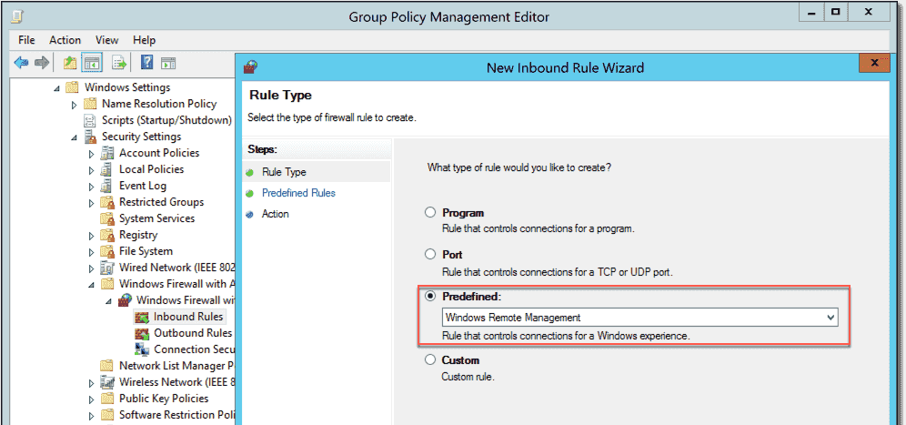
Enabling PSREMOTING with Group Policy
Computer Configuration >
Policies >
Windows Settings > Security Settings >
Windows Firewall with Advanced Security
Notes:
Poke a hole in firewall… super simple.. Predefined rule…

Slide 20
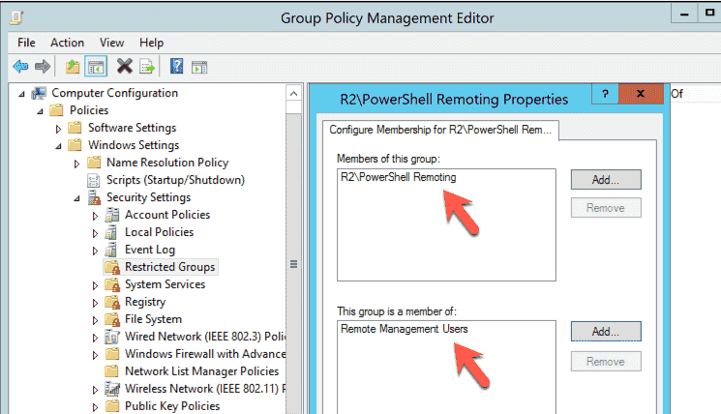
Controlling access to remote nodes
Computer Configuration > Policies > Security Settings > Restricted Groups
Notes:
Make an AD group (top box)
Add to an existing local group (bottom box)

Slide 21
PSRemoting & IP Filtering
Notes:
Enabling WINRM
Filtering IP sources (allow connections through firewall)
This is where it gets interesting…
Talk about jump boxes and clients that do not need to initiate connections
Combo of IP filtering at firewall and remote management users group is a powerful way to limit connections.

Slide 22
Enabling PSREMOTING: Summary
Enable WINRM Service and set to auto start
Configure Windows Firewall Exception
Decide who gets access
Decide where connections can be initiated from
Decide how you will implement settings (cmd line, GPO or both)
Notes:
Knowing this process builds trust
Trust allows the security team or exec mgmt to do the things you ask for

Slide 23

PS REMOTING: What ELSE?
I’ve talked almost exclusively about authenticating users
SSL & certs verify computer identities
JEA is next logical step
SSL & Certificates allow PowerShell remoting to use HTTPS port 5986 in addition to HTTP port 5985
Logging activity is critical for understanding what is happening
Notes:
And that leads to me to part 2 of this presentation….

Slide 24
Logging Powershell Activity
Module Logging
Script Block Logging
Transcription
Notes:
No right combination of settings by default.
You have to figure whats right for you and your org

Slide 25

Powershell Logging: Module Logging
Module logging grabs activity related to specific modules Example: logging all activity from the Active Directory Module cmdlets
Events are written to the Windows PowerShell log
Can produce a large volume of events. Increase log size to 1 GB if possible

Slide 26
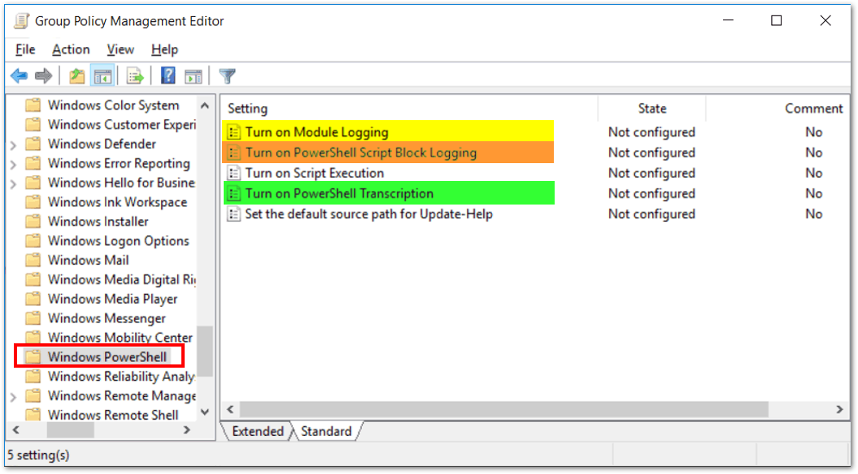
Powershell Logging: Module Logging
Computer Configuration > Policies > Administrative Templates > Windows Components > Windows PowerShell

Slide 27
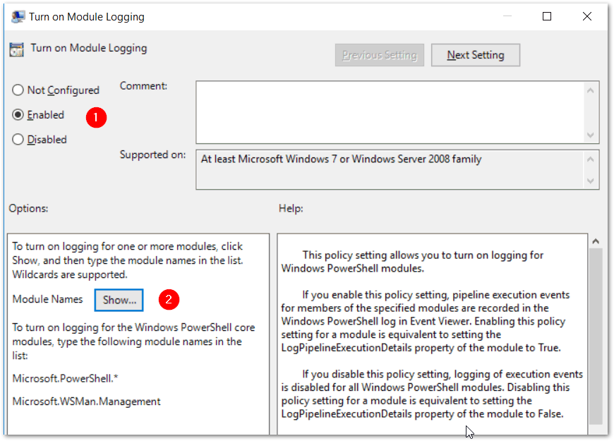
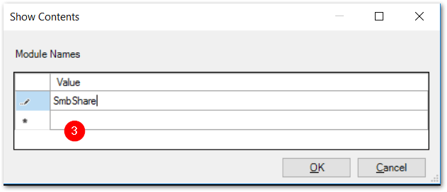
Powershell Logging: Module Logging

Slide 28
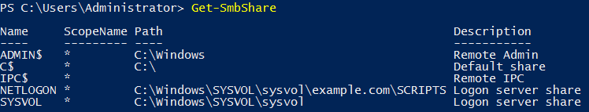
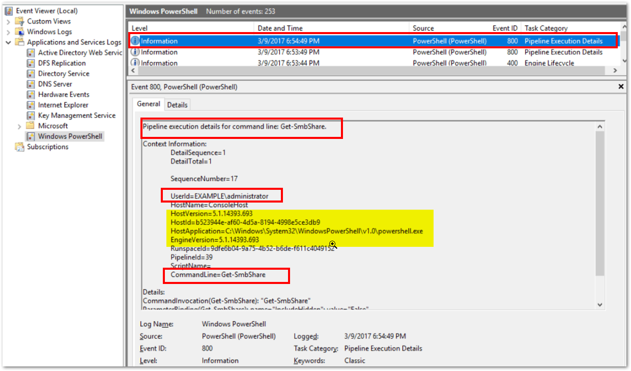
Powershell Logging: Module Logging

Slide 29

Powershell Logging: Script block Logging
Script Block logging records blocks of code as they are executed by the PowerShell engine
Events are written to the Windows PowerShell log (Event IDs# 4104, 4105 & 4106)
PowerShell 5.0 automatically logs code blocks if the block’s contents match on a list of suspicious commands or scripting techniques, even if script block logging is not enabled.
Produces less logs than Module Logging but still can be noisy.

Slide 30
Powershell Logging: Script block Logging
Computer Configuration > Policies > Administrative Templates > Windows Components > Windows PowerShell

Slide 31
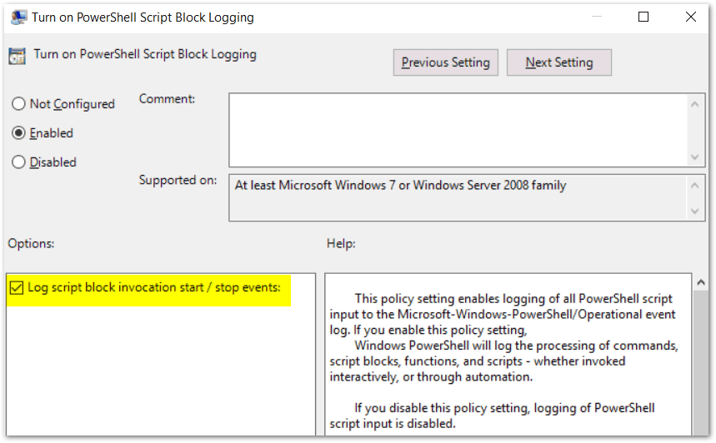
Powershell Logging: Script block Logging

Slide 32
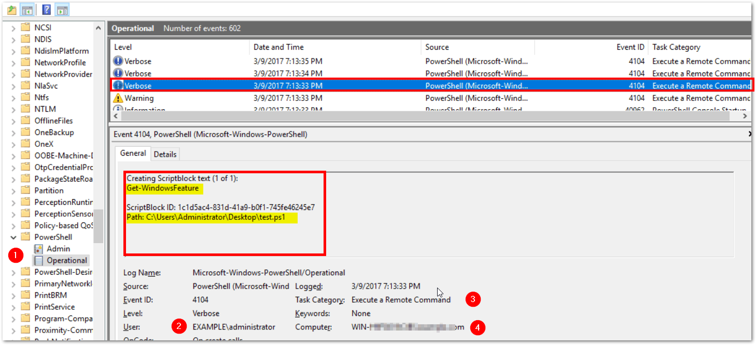
Powershell Logging: Scriptblock Logging

Slide 33

Powershell Logging: TRANSCRIPTION
Transcription creates a unique record of every PowerShell session, including all input and output, exactly as it appears in the session.
Transcripts are written to text files, broken out by user and session.
WARNING: Transcription will capture passwords to the log in clear text!

Slide 34
Powershell Logging: TRANSCRIPTION
A common config for transcription is to write the logs to a local folder on each pc you want to capture history on.
Then, create a scheduled task that sweeps the logs off each machine into a share on a server once a day.
Finally compress the text files in a daily zipped archive.

Slide 35
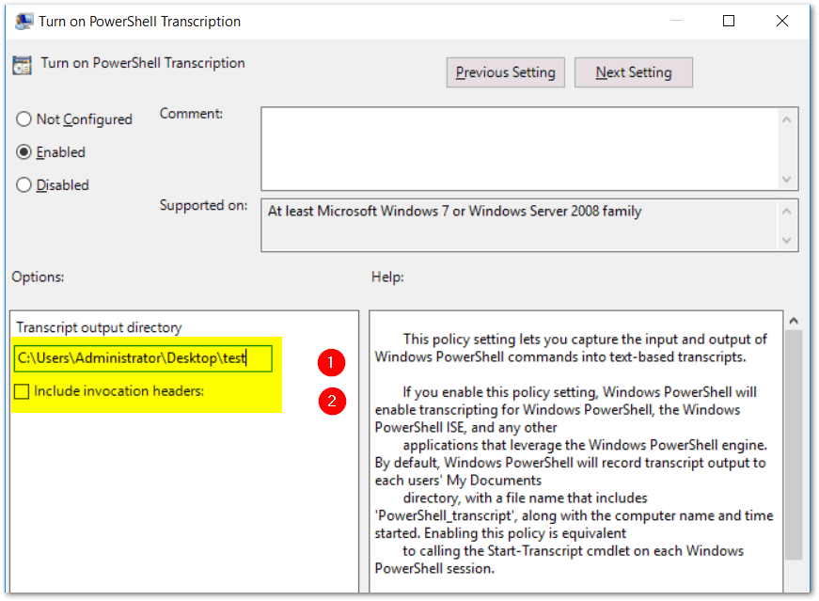
PowerShell Logging: Transcription
Notes:
Transcription starts when the session is created
Invocation headers will recording the start of each cmd invoked

Slide 36
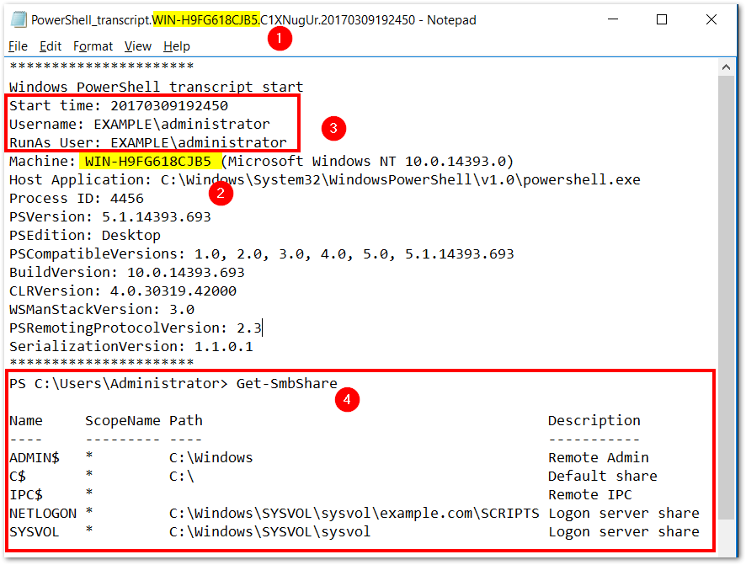
PowerShell Logging: Transcription

Slide 37
PSLogging: Summary
Three different logging options
Two options write to event logs
Transcription produces flat text files
Logging can fill up the eventlog quickly. Increase log size to 1GB or greater if possible
The right combination of logging is determined by you

Slide 38
Wrapping it all up
How secure PowerShell Remoting is depends on your security posture on your end nodes
PS Remoting uses secure protocols and AD authentication
PS Remoting can be configured easily via Group Policy
You can capture nearly every PS command typed into a PowerShell cmd prompt from any PC in your domain if you choose so. But doing so has an impact.
There is no one size fits all setting for PS Remoting & Logging
PS Remoting is safe and you should be enabling it!

Slide 39

Selling PSRemoting to your InfoSec Team

Slide 40

Let’s get that InfoSec team onboard!
Knowledge is the key! Know the parts of the puzzle
Be able to explain WHY remoting helps you do your job!
Highlight that PowerShell is one of the most configurable and auditable options available from Microsoft
The other choices are worse for an InfoSec team
Its all about risk tolerance

Slide 41


